Slide 1
Classifying Cybersecurity Incidents with Machine Learning
Cybersecurity and Machine Learning

Slide 2
Enhancing Cybersecurity Incident Triage with Machine Learning
Overview
In modern enterprise environments, Security Operation Centers (SOCs) play a crucial role in detecting, analyzing, and responding to cybersecurity threats. However, SOC analysts often face an overwhelming number of security alerts, many of which turn out to be false alarms. This makes it difficult to efficiently prioritize real threats.
To solve this problem, we aim to develop a machine learning model that can accurately classify cybersecurity incidents into one of three categories:

Slide 3
1)True Positive (TP) – A legitimate security threat requiring immediate action.
2) Benign Positive (BP) – An alert triggered by normal system behavior, requiring no action.
3)False Positive (FP) – A misclassified alert that does not indicate a real security issue.
By leveraging historical incident data from the GUIDE dataset, we will train a classification model that helps SOC analysts prioritize real security threats while reducing unnecessary investigations of false alarms.

Slide 4
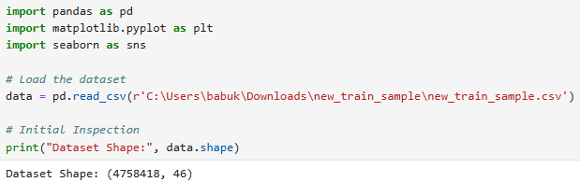
Data Exploration and Understanding:
Load and Inspect Data:
let's load the dataset and explore its structure.
train_df.info() helps identify data types (numerical/categorical).
train_df.head() gives an overview of how the data looks.

Slide 5
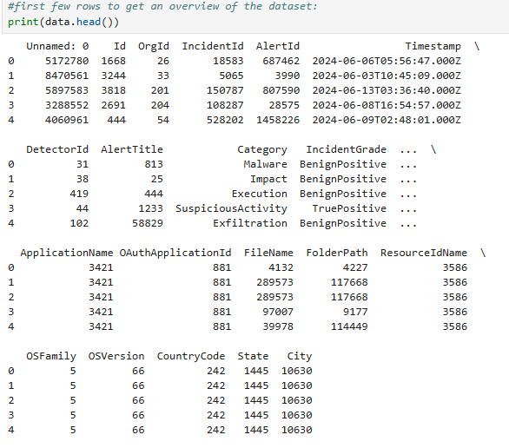
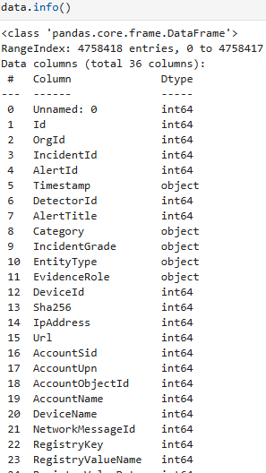

Slide 6
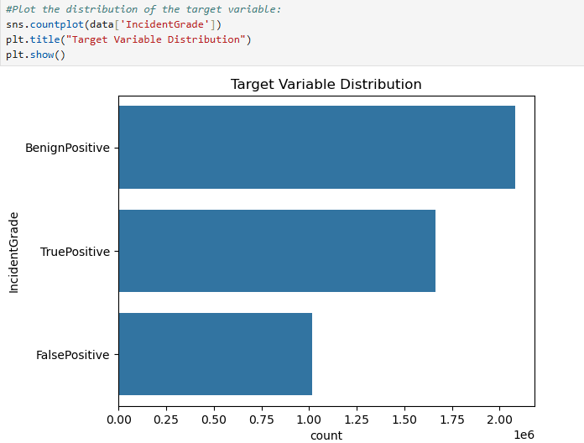
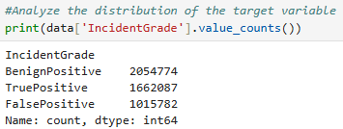
Check Target Variable Distribution:
we are solving a classification problem, it's essential to check how balanced our target variable (IncidentGrade) is.

Slide 7
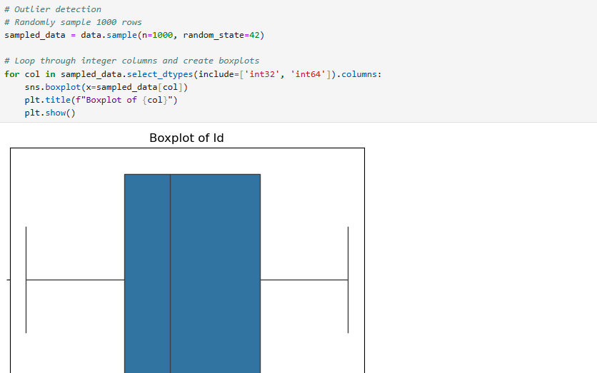
Identify Outliers:
We identified outliers in each column of the training dataset by analyzing a sample of 1,000 rows using a boxplot.

Slide 8
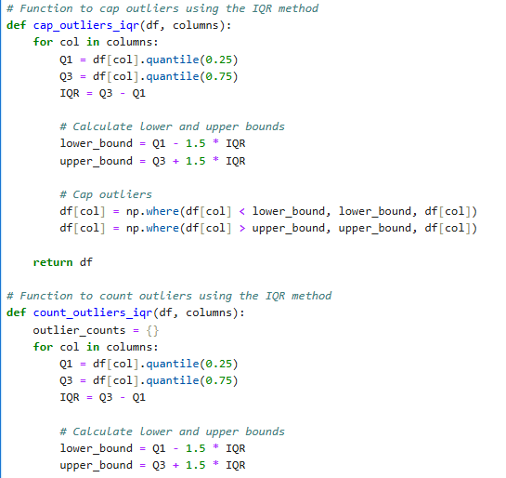
Outlier Method:
Handles outliers in a dataset using the Interquartile Range (IQR) method. It consists of two functions:
cap_outliers_iqr(df, columns) – Capping Outliers:
This function caps (limits) the outliers instead of removing them.
Any values below the lower bound are replaced with the lower bound.
Any values above the upper bound are replaced with the upper bound.
This prevents extreme values from affecting the model while preserving data.

Slide 9
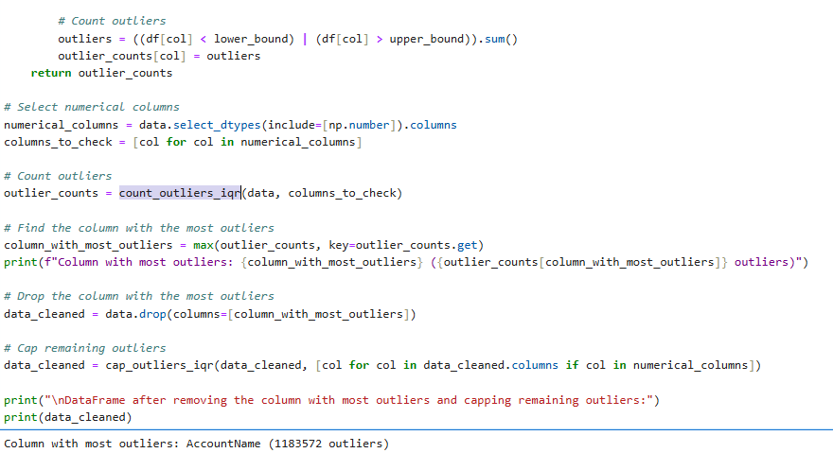
count_outliers_iqr(df, columns) – Counting Outliers:
This function counts the number of outliers in each column.
It calculates the same IQR-based bounds as in the previous function.
It counts how many values in the column are below the lower bound or above the upper bound.
It returns a dictionary with column names and their corresponding outlier counts.
Identifies the column that has the maximum number of outliers.
Drops that column from the dataset.

Slide 10


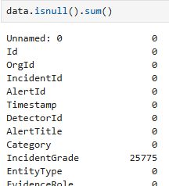
Data Preprocessing:
Handle Missing Values
Missing values must be handled before training the model.
If the column has less than 75% of missing values then remove the column.

Slide 11
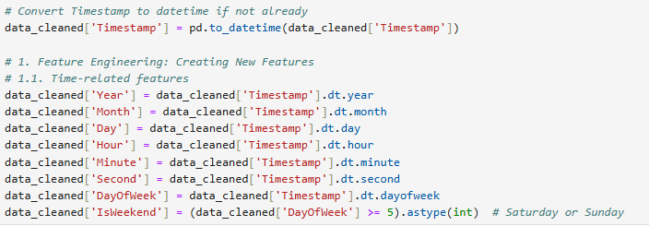
Feature Engineering:
From the Timestamp column we have created the deriving new features from timestamps (like hour of the day or day of the week)

Slide 12
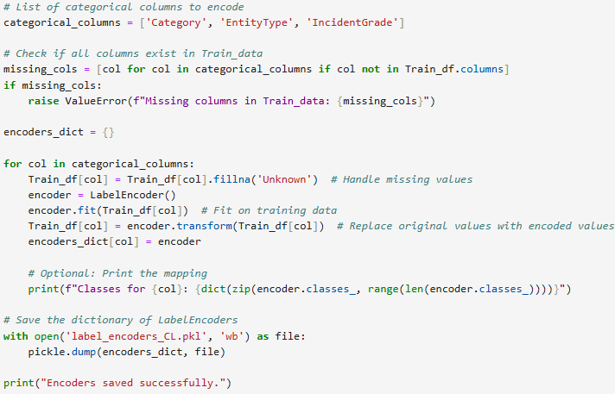
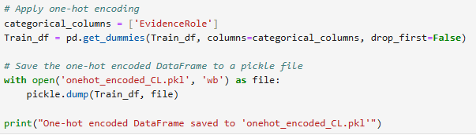
Encode Categorical Variables:
Machine Learning models only work with numerical data, so we convert categorical features.

Slide 13
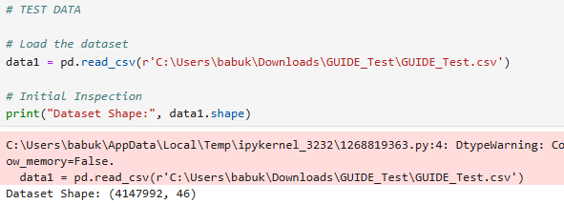
TEST DATA:
Read the test data.
Do the Handling missing values, Treating outliers and encoding variables same as of train dataset.

Slide 14
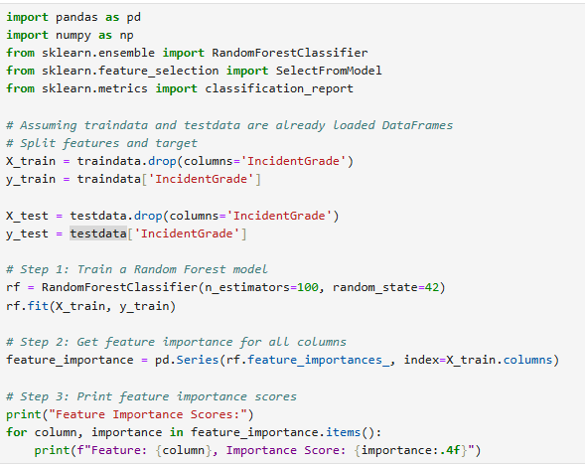
Feature Selection:
traindata and testdata are assumed to be preloaded pandas DataFrames.
The target variable (IncidentGrade) is separated from the feature set.
X_train and X_test contain all features except IncidentGrade.
y_train and y_test contain only the target labels.
A Random Forest classifier is trained on the full feature set.
n_estimators=100: Uses 100 decision trees in the forest.
random_state=42: Ensures reproducibility.

Slide 15
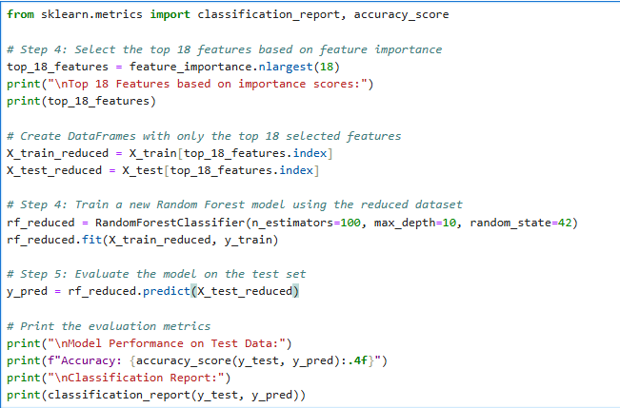
feature_importances_ provides the importance score for each feature.
These scores indicate how much each feature contributes to predicting IncidentGrade.
Selects the 18 most important features based on the feature importance scores.
This step reduces dimensionality and improves model performance by removing less relevant features.
Trains a new Random Forest model using only the selected features.
max_depth=10: Limits the depth of each tree to prevent overfitting.
Uses the trained model to predict IncidentGrade on the test set.

Slide 16
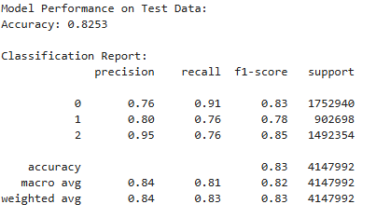
Random Forest Model:
Overall Accuracy: 82.53% (Good performance)
Precision: Measures how many of the predicted positive cases were actually correct.
Class 2 has the highest precision (95%), meaning very few false positives.
Recall: Measures how many actual positive cases were correctly identified.
Class 0 has the highest recall (91%), meaning it captures most actual 0 instances.
F1-Score: The harmonic mean of precision and recall.
Class 2 has a strong F1-score (85%), indicating balanced precision and recall.
Key Takeaway: The model performs well across all classes, but Class 2 has a high precision and lower recall, indicating some missed cases.
Use Random Forest when:
You want higher accuracy and better generalization.
The dataset is large and has complex patterns.
You need a balanced model across all classes.

Slide 17
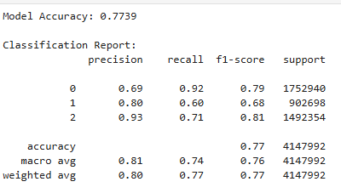
Decision Tree Model:
Overall Accuracy: 77.39% (Lower than Random Forest)
Precision:
Similar to Random Forest but slightly lower.
Recall:
Class 0 still has the highest recall (92%), but Class 1 is significantly lower (60% vs. 76% in Random Forest).
F1-Score:
Lower than Random Forest across all classes.
Key Issue: Class 1 recall is low, meaning the Decision Tree misses more instances of Class 1.
Use Decision Tree when:
You need a simpler, interpretable model.
Computational efficiency is a concern (Random Forest is slower).
Overfitting is not a major issue.

Slide 18
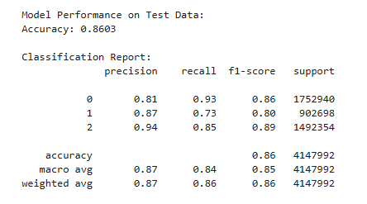
XGBoost Model
Accuracy:
86.03% (Good overall performance)
Precision:
High for TP (0.94), lower for FP (0.81) and BP (0.87)
Recall:
FP (0.93) and TP (0.85) are well captured, but BP (0.73) is lower
F1-Score:
Balanced performance across classes, but BP is slightly weaker
Key Takeaway:
The model performs well but struggles with BP recall (73%)
Use XGBoost when:
You need high accuracy and robust performance.
Your dataset is large and structured (tabular data).
You want to handle missing values automatically.
You need feature importance insights.
Your problem involves imbalanced data (XGBoost handles this well).
You require fast training and efficient memory usage.

Slide 19
